Slide 1

Cancer and how it relates to different aspects of daily life.
Cody Carpenter
Jake Rohbock
Johnny Ramirez
Samantha McKay

Slide 2



Data Collection
Retrieved our data from Kaggle.
https://www.kaggle.com/datasets/topolphukhanh/cancer-reg
Healthcare Dataset
Cleaning:
Renamed Columns
Created Columns

Slide 3
Agenda
Is there a correlation between income and cancer rates?
Do older populations have greater or lower poverty rates?
Does a higher percent of married households correlate with lower incidences of death as the outcome?
What percentage of cancer incidences result in death in each state on average?
What is the relationship between unemployment and cancer incidence for each state?
Does not having insurance correlate with a higher death rate from cancer?

Slide 4

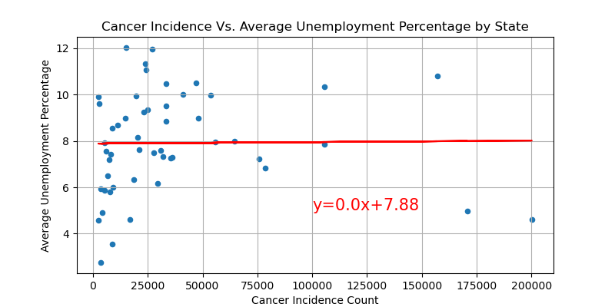
Unemployment and Cancer Incidence
R Value= 0.013
P Value=0.928
Notes:
Strength= weak
form= nonlinear
direction=random, neither positive nor negative

Slide 5
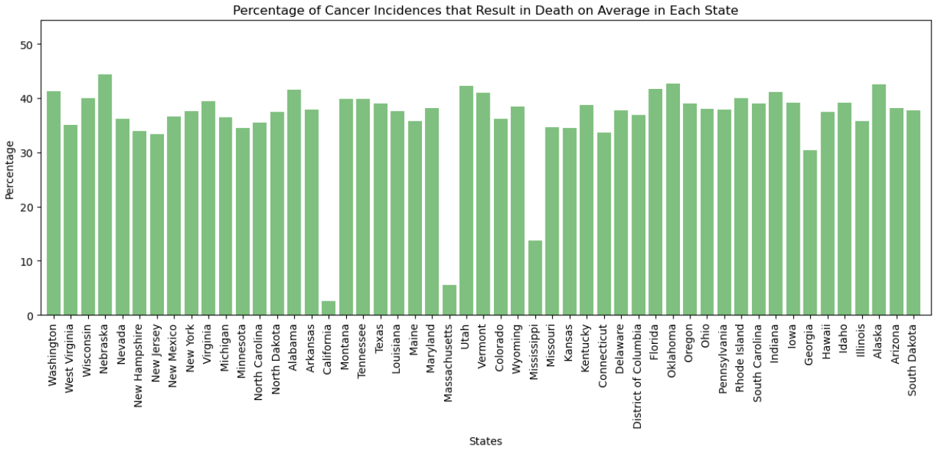
Cancer Death by State
Notes:
Y axis is represented with percentage of people who were diagnosed with cancer who ended up dying.
X axis is represented by each state
Outliers were California, Massachusetts, and Mississippi.
Further studies would need to be conducted to understand why these 3 states reported such lower average death percentages from those that were diagnosed.

Slide 6
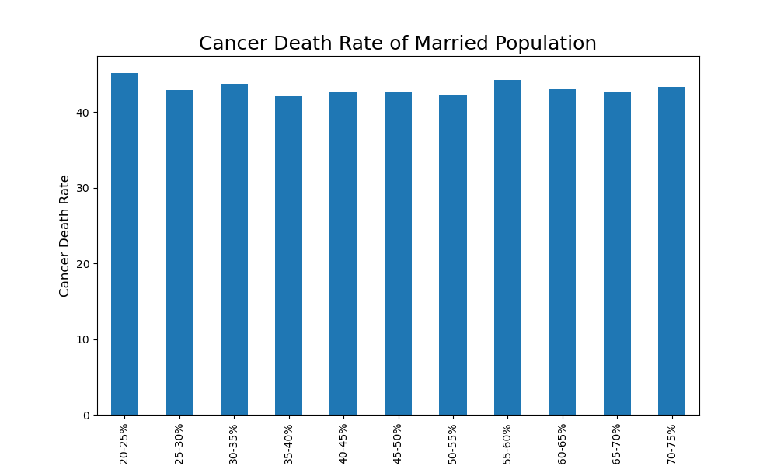
Marriage and Death
Notes:
Hypothesis: Higher marriage rates would lead to faster detection of cancer and less incidences of death from cancer.
Visually, there is no correlation between marital status and risk of dying from cancer.
Added age to see if areas with older people tend to have higher marriage rates.
https://onlinelibrary.wiley.com/doi/abs/10.1111/ecc.12755
Other information that would have been helpful: type of cancer, stage of cancer, information on what year this data was collected. How the data was collected?

Slide 7
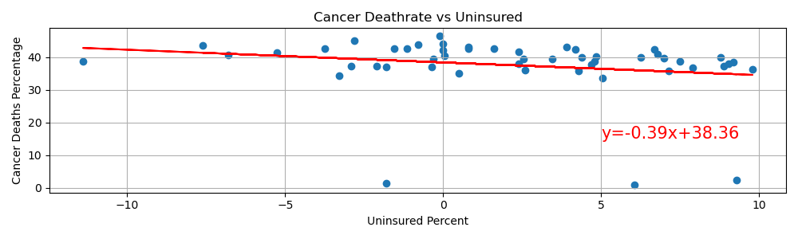
Insurance and Death
R Value= -0.198
P Value= 0.164
Notes:
Hypothesis: Higher marriage rates would lead to faster detection of cancer and less incidences of death from cancer.
Visually, there is no correlation between marital status and risk of dying from cancer.
Added age to see if areas with older people tend to have higher marriage rates.

Slide 8
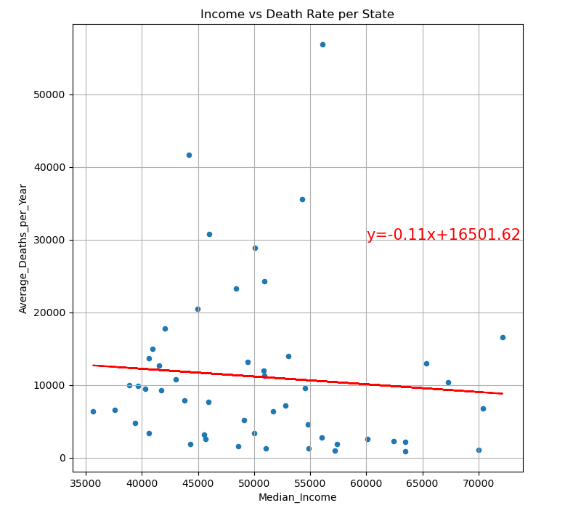
Income and Death
R Value= -0.087
P Value=0.545

Slide 9
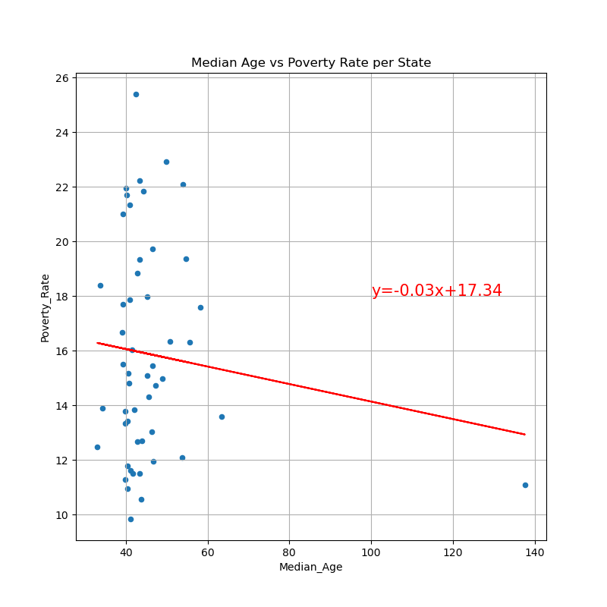
Poverty and Death
R Value= -0.118
P Value=0.409

Slide 10
Key Takeaways from Project 1
In Future:
Remove Outliers
Find data that:
Shows the source the data was taken from.
Lists the type of cancer.
The stage that the cancer was diagnosed.
The time between diagnosis and death.
Trust the ratings on Kaggle.

Slide 11
Summary of Findings
No correlation was found between income, unemployment, marital status, state, age or insurance status and cancer or death from cancer.

Slide 12

Summary
No correlation was found between income, unemployment, marital status, state, age or insurance status and cancer or death from cancer.

